Slide 1
17th May, 2019 Single-Cell Omics
Single-cell genomics data analysis focusing on Strand-seq
¹David Porubsky, ²Hyobin Jeong
¹Dichler Lab, Department of Genome Sciences, University of Wachington
²Korbel Group, Genome Biology, EMBL
Notes:
check if you put all your 2017 lab meeting presentations on the korbel drive under \shared\presentations_group\2016

Slide 2
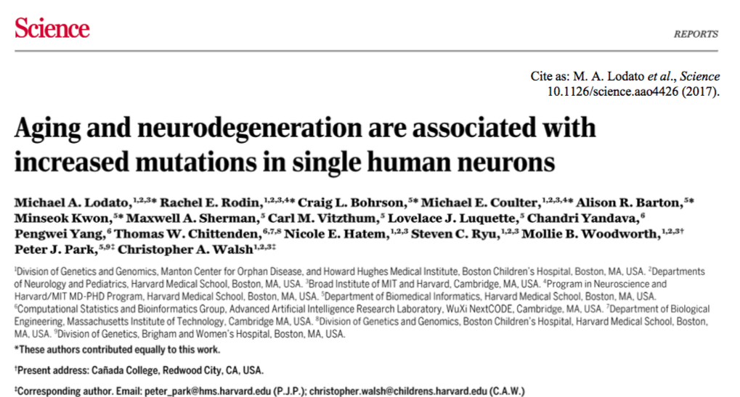

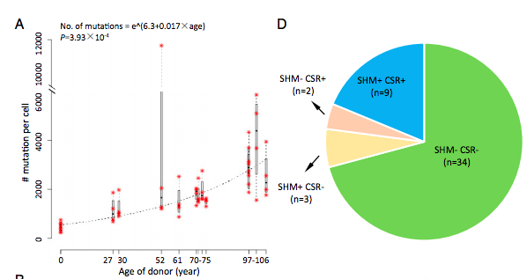
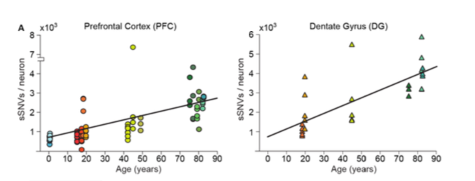
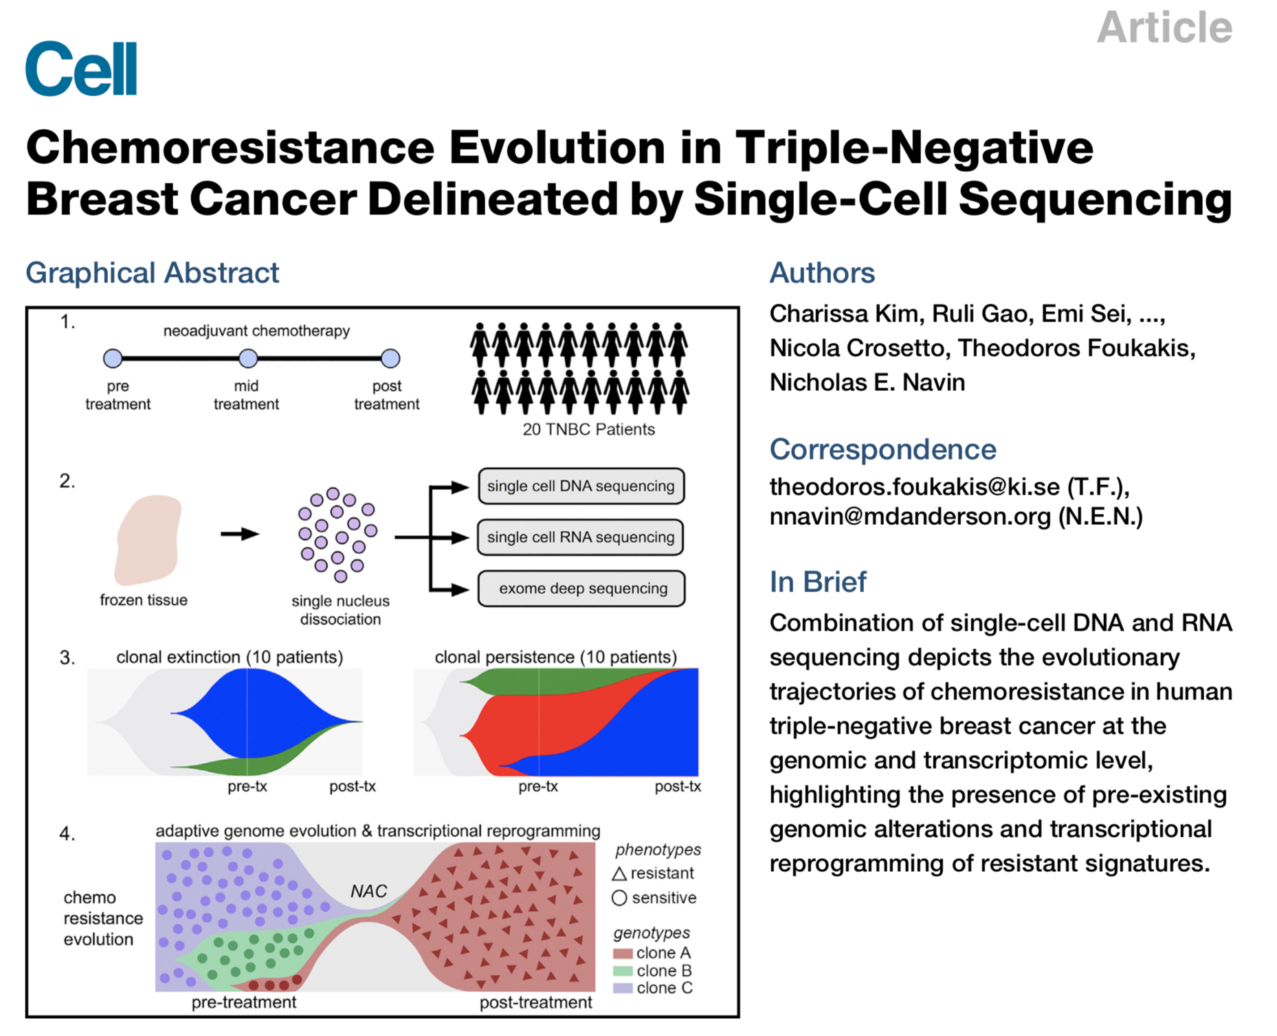
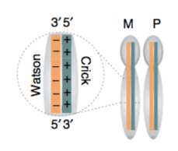
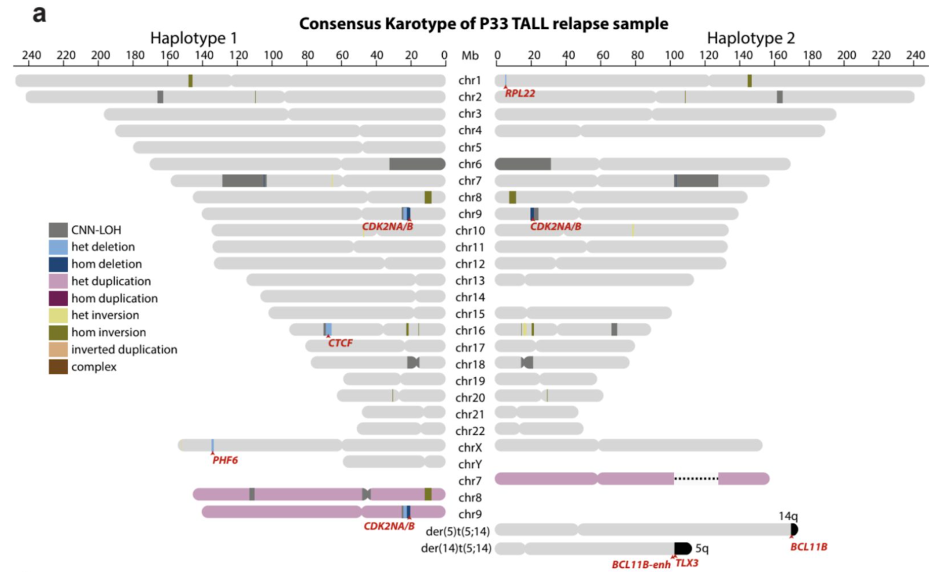
Current studies based on the single-cell genomics
Neuronal Mosaicism during Aging
Clonal hematopoiesis
Breast Cancer Mutation
Cancer Structural Variation

Slide 3
Overview of the single-cell genome data analysis – WGS
Single-cell whole-genome-seq
Strand-seq
Neuronal Mosaicism
Clonal hematopoiesis
Breast Cancer mutation
Cancer Structural Variation
Step1. Alignment - Finding a correct position of reads: Bowtie2, BWA
Step2. Remove PCR duplicate: Picard mark duplicate, Biobambam
Step3. Genotyping, Segmentation: Freebayes, GATK, CBS
Step4. Mutation, SV (copy-number variation, inversion, translocation) calling: SCcaller, AneuFinder
Step5. Single-cell clustering and Phylogenetics: phangorn, TimeScape
Notes:
CBS : circular Binary Segmentation

Slide 4
Overview of the single-cell genome data analysis – Strand-seq
Single-cell whole-genome-seq
Strand-seq
Neuronal Mosaicism
Clonal hematopoiesis
Cancer mutation
Cancer Structural Variation
Step1. Alignment - Finding a correct position of reads: BWA
Step2. Remove PCR duplicate: Biobambam
Step3. Genotyping, Segmentation: Freebayes, StrandPhaseR, BreakpointR
Step4. Mutation, SV (copy-number variation, inversion, translocation) calling: MosaiCatcher
Step5. Single-cell clustering and Phylogenetics

Slide 5
Short DNA Read Mapping: An Algorithmic Tour
Bulk data
Single-cell data
Proc IEEE Inst Electr Electron Eng. 2017
Additionally, for Strand-seq, orientation of the reads need to be considered!
Notes:
3) BWT-based methods: Among the most widely used software tools used for mapping short DNA reads to a reference genome are Bowtie and ist successor Bowtie2, as well as BWA and BWA-SW. At the core of all of these programs lies the FM-index, which allows them to use the Burrows-Wheeler transform (BWT) as a suffix array-like index structure. Simply speakingm the FM index augments the space-efficient BWT with additional data that permits very fast exact string matching.
The first and most obvious criterion for the practical utility of a read mapper is ist efficiency, both in time and space. For these very large data sets, even constant factors matter, and an algorithm that runs twice as fast can save literally years of CPU time. Space matters as well, in part because the most common text, the human genome is 3 billion bases long. An index that fails to represent the text efficiently may require tens of gigabytes of real memory, an amount that exceeds the standard memory available on most computig grids. This explains why the BWT-based FM-index, first implemented in the Bowtie and BWA read mappers, was adopted almost immediately by large numbers of users.
Short Read Mapping: An Algorithmic Tour Stefan Canzar and Steven L. Salzberg

Slide 6
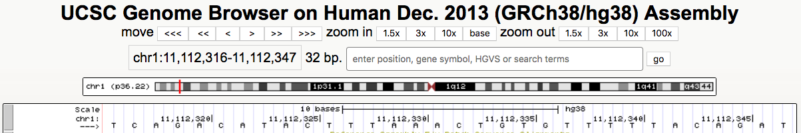
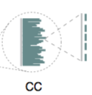
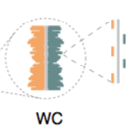
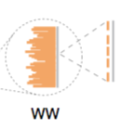
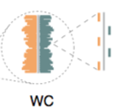
Orientation of the reads are the key of Strand-seq data analysis
Crick (C) aligns to the plus (forward) strand of the reference assembly
Watson (W) aligns to the minus (reverse) strand
Forward (+)
→ Crick
Sanders et al. Nature protocol, 2017
Chromosome1
Cell C
Cell E
Cell G
Cell A
Cell H
Cell D
Cell F
Cell B
Notes:
https://www.biorxiv.org/content/10.1101/271510v1.full

Slide 7
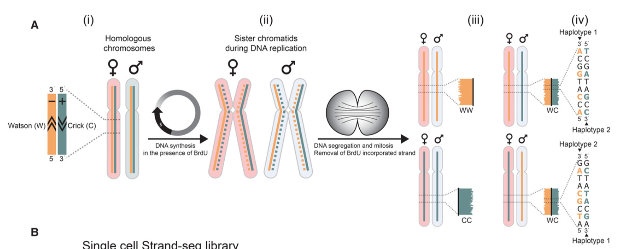
Orientation of the reads gives chromosome length scale haplotype information
Porubsky et al. Genome Res, 2016
Why haplotype phasing is important?
Variant-disease associations
Mapping regions with loss of heterozygosity
Inheritance patterns in pedigrees
How can we know the orientation of the sequencing read from the bam file?

Slide 8
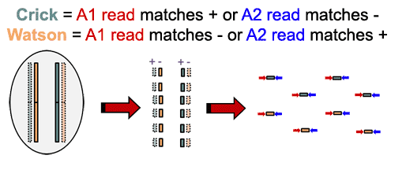
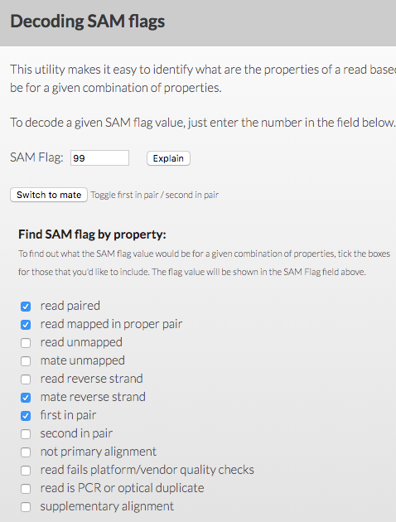
Classify reads into Crick and Watson using bamfile and samtools
https://sourceforge.net/p/bait/wiki/
##Crick reads
samtools view -f 99 output.bam > A1_C.txt
samtools view -f 147 output.bam > A2_C.txt
##Watson reads
samtools view -f 83 output.bam > A1_W.txt
samtools view -f 163 output.bam > A2_W.txt
https://broadinstitute.github.io/picard/explain-flags.html

Slide 9
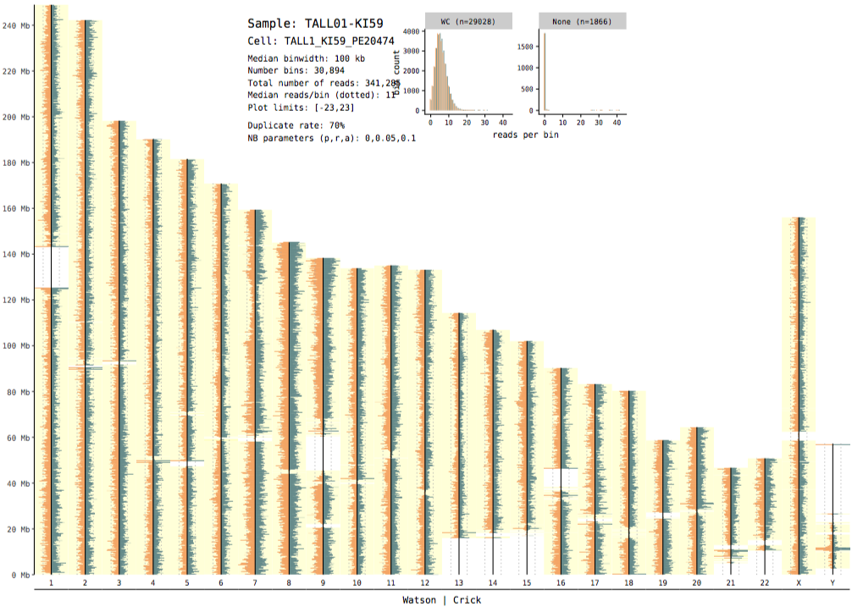
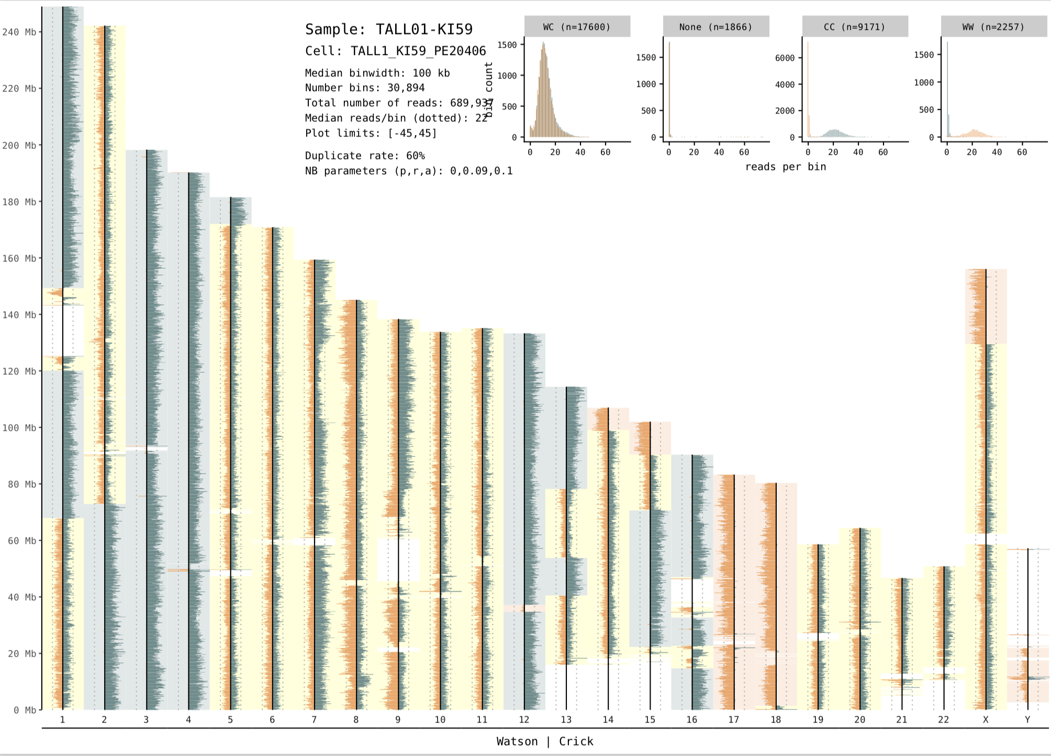
Quality check: Which one is the good quality Strand-seq library?
Whole-genome seq
Strand-seq
In a successful Strand-seq library derived from a diploid cell, expect to see ~50% of the chromosomes exhibiting either a WW or CC state.
If all chromosomes in the library have a WC inheritance pattern, Strand-seq was probably unsuccessful for that cell.
By assessing the genomic coverage, level of background and proportion of WW:WC:CC chromosomes for each library, the success rate of the experiment can be assessed and successful libraries selected for further analysis
Notes:
Single-Cell RNA-Seq Reveals AML Hierarchies Relevant to Disease Progression and Immunity

Slide 10
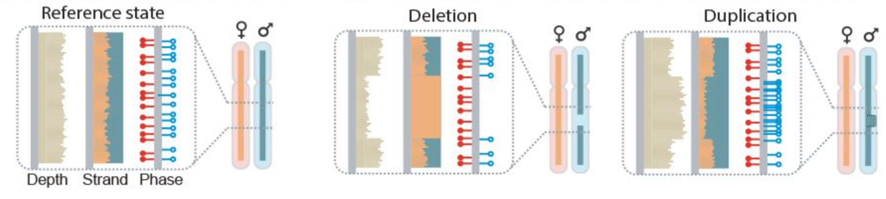
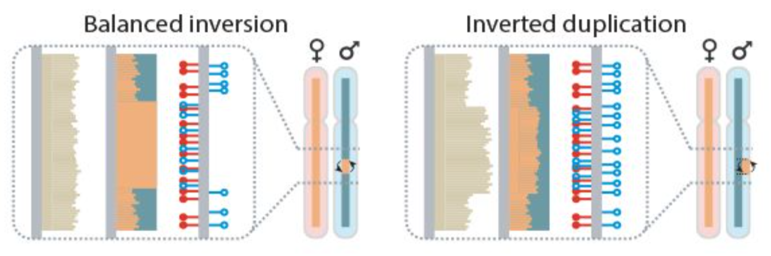
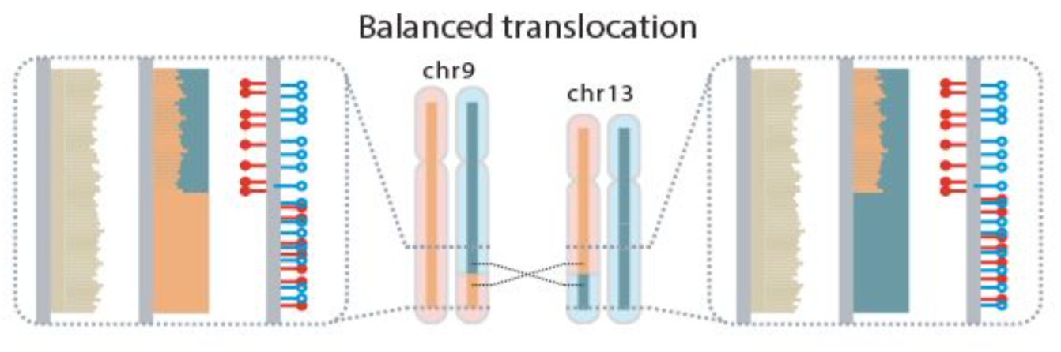
MosaiCatcher to detect characteristic footprints of SVs from Strand-seq data
Input: single-cell BAM files
Workflow management: Snakemake
Binned read counting (100kb) and normalization
Assign strand-specific read data into genomic bins
Detects and haplotype-phases heterozygous SNPs
Segments the single cell sequence data
Calculates genotype likelihoods for each segment and single cell
Notes:
Single-Cell RNA-Seq Reveals AML Hierarchies Relevant to Disease Progression and Immunity

Slide 11
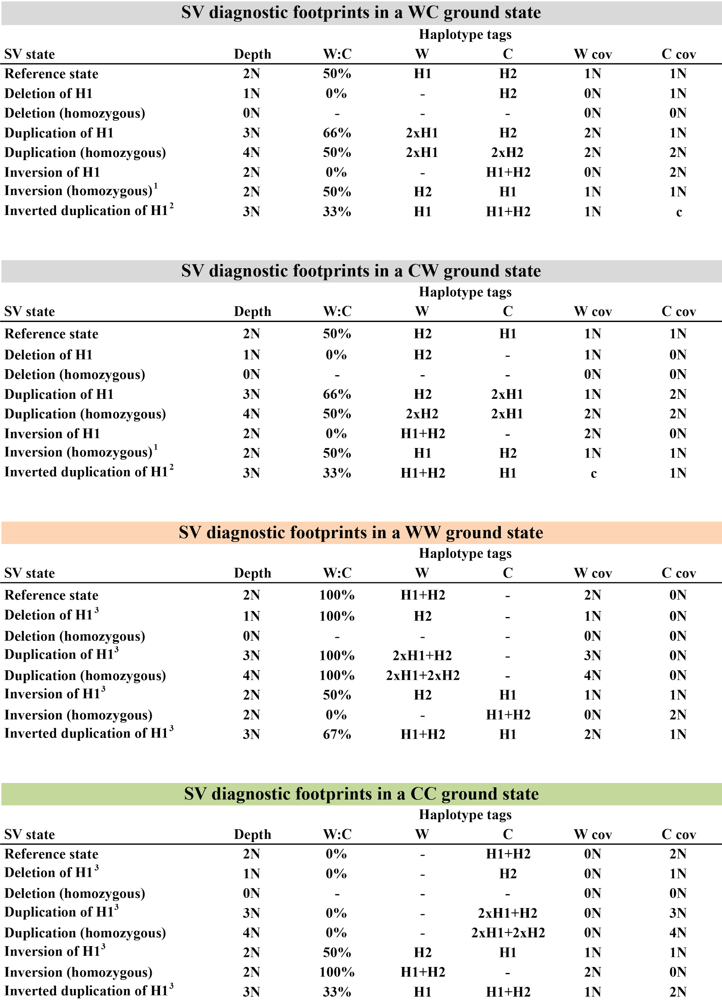
Translation of diagnostic footprint into expected number of copies in W and C
Negative binomial (NB) distribution is the basis for this Bayesian framework (p, r)
Parameters (p, r) are estimated from the observed read counts
Each SV diagnostic footprint can be translated into the expected number of copies sequenced in W and C orientation
These expectations are formalized in Bayesian model

Slide 12
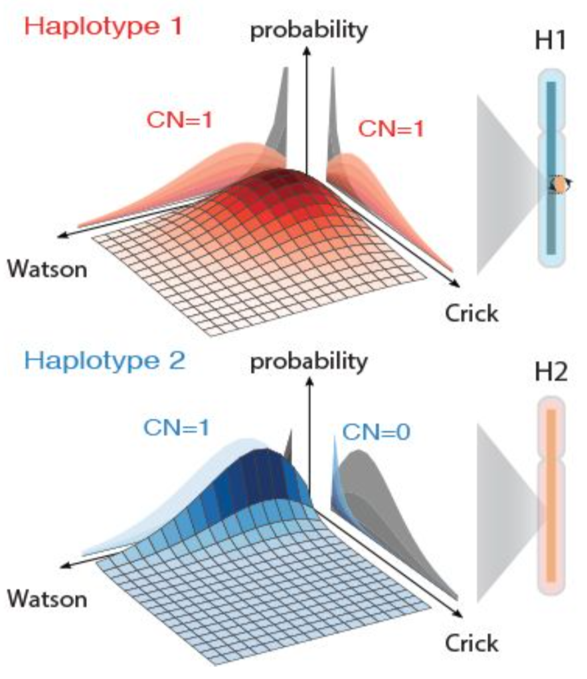
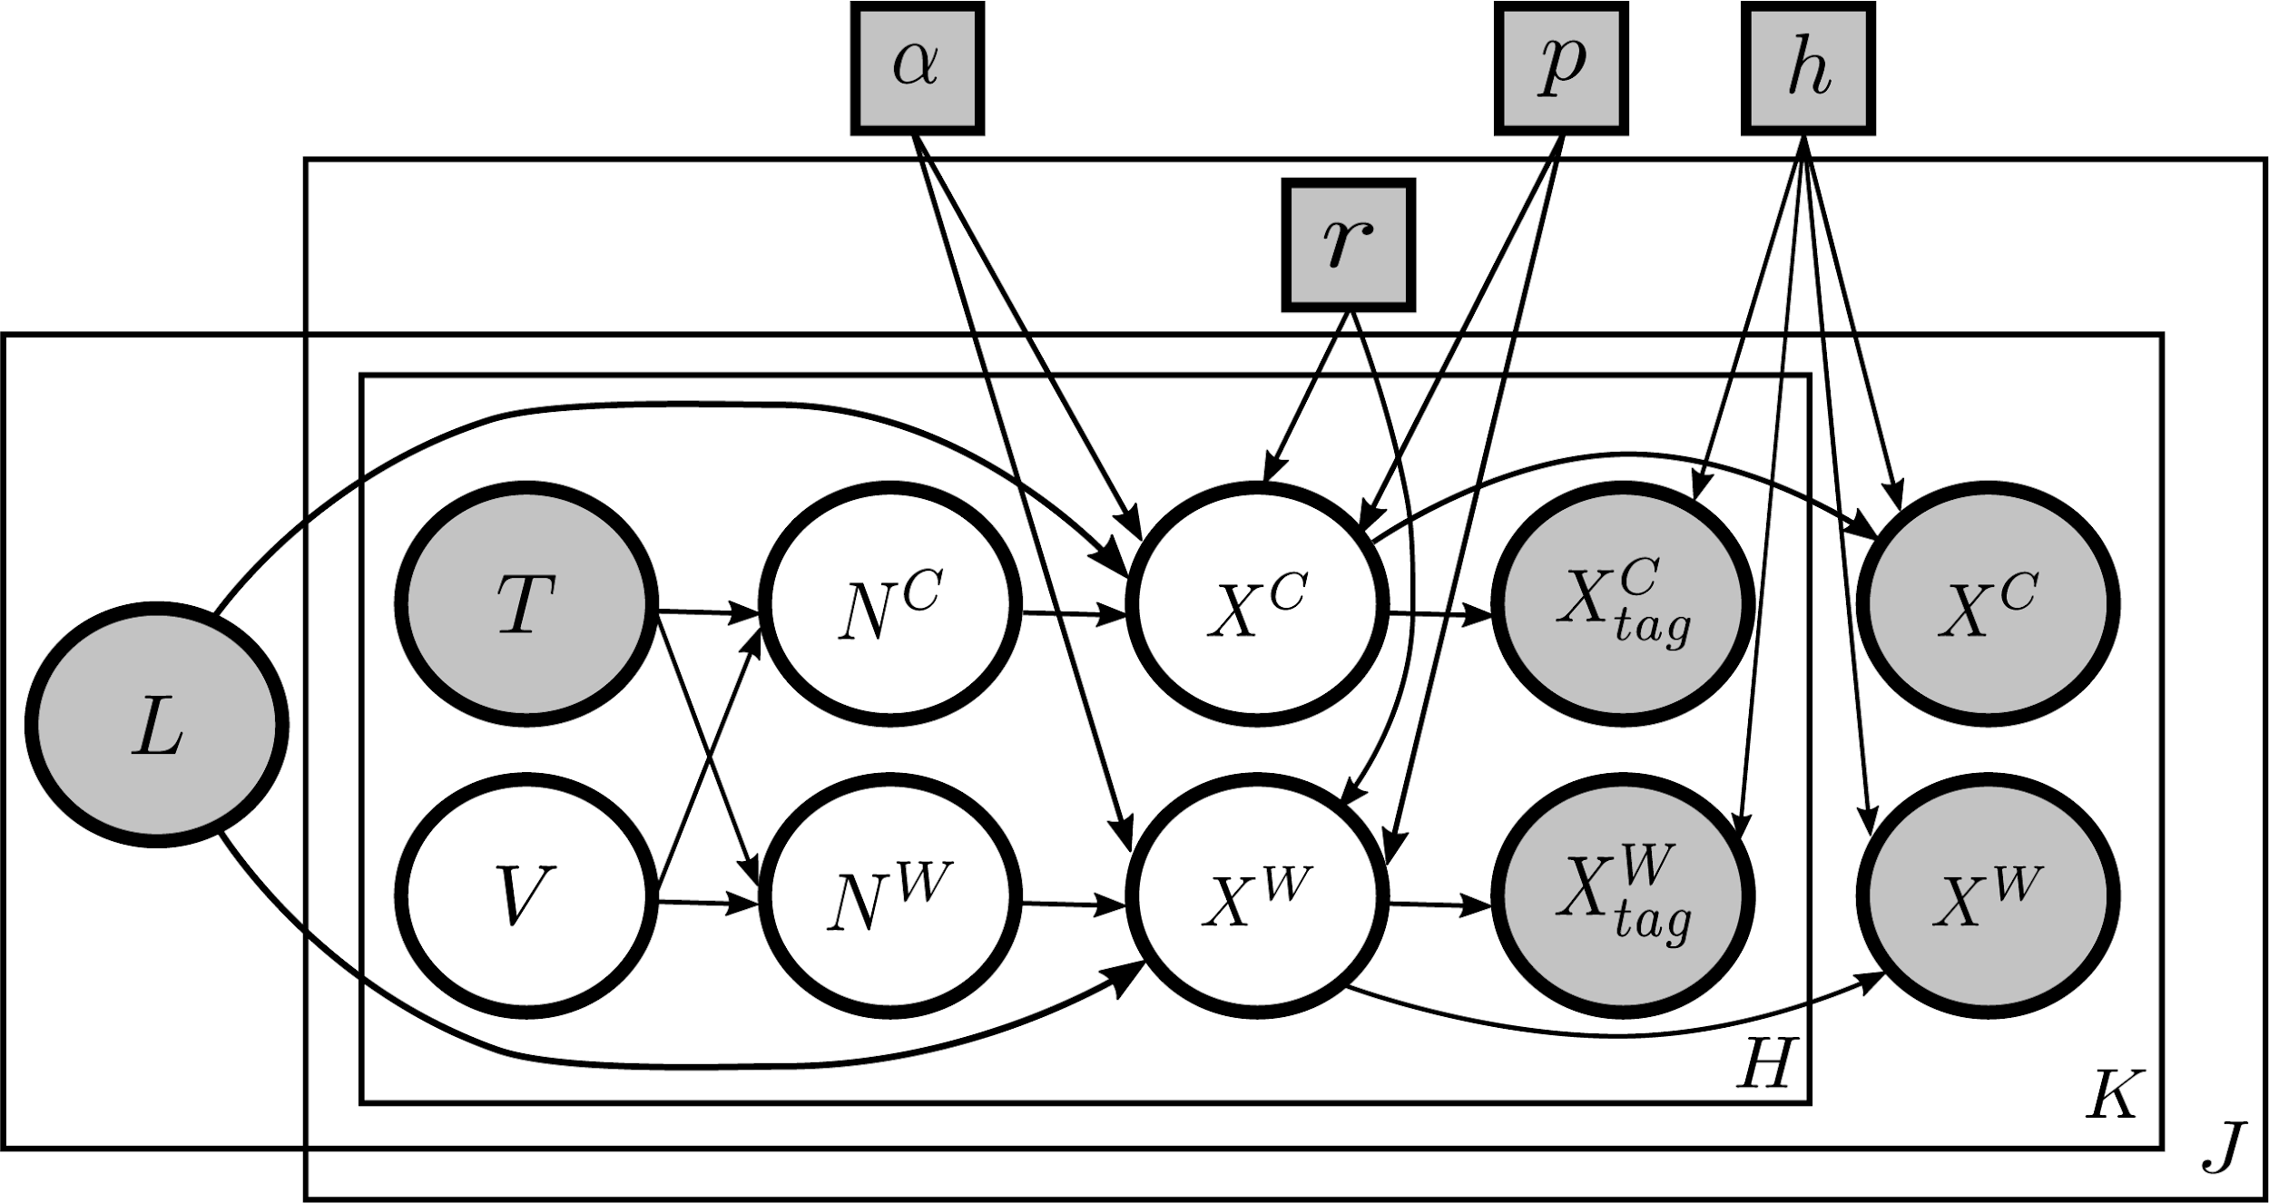
MosaiCatcher uses Bayesian model for SV genotype likelihoods in single cells
Every haplotype-resolved SV class in a segment together with the ground state define a Watson and Crick copy number used to compute the NB likelihood of observed read counts.
SV call is accepted if the log odds ratios (of an SV genotype vs. the reference state) was at least 4
The probability distributions represent an InvDup on H1
Segments on both strands are seen for haplotype 1 (H1), but H2 is represented on the W strand only
Genotype likelihood

Slide 13
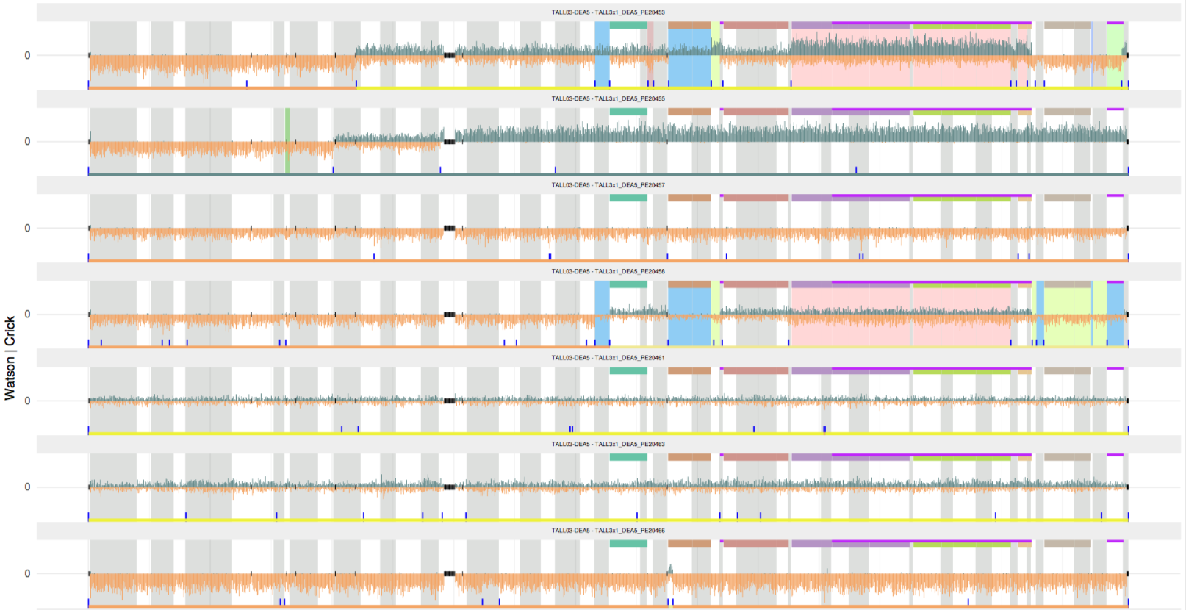
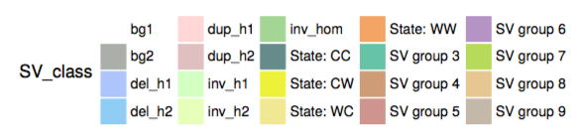
Chromosome plot with SVs called by MosaiCatcher framework
Strand-seq from T-ALL PDX (P1) Chromosome6

Slide 14
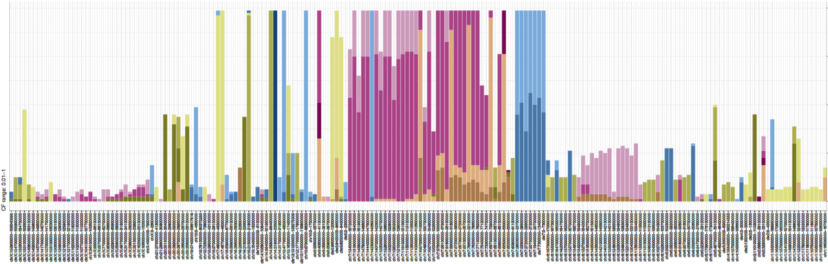
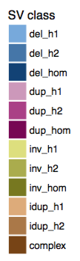
Variant allele fraction of SVs called by MosaiCatcher framework
Strand-seq from T-ALL PDX (P1)
Variant allele fraction (VAF)
If the VAF is close to 1, the SVs are expected to be germline variant
If the VAF is below 1, the SVs are expected to be somatic variant
If the SVs only detected by one cell, it can be rare SV event, or an SCE (sister chromatid exchange) event
SCEs happen independently in each single cell, and unlike SVs, SCEs are not transmitted clonally to daughter cells. Hence, changepoints resulting from SCEs are very unlikely to recur at the same position in >1 cell of a sample

Slide 15
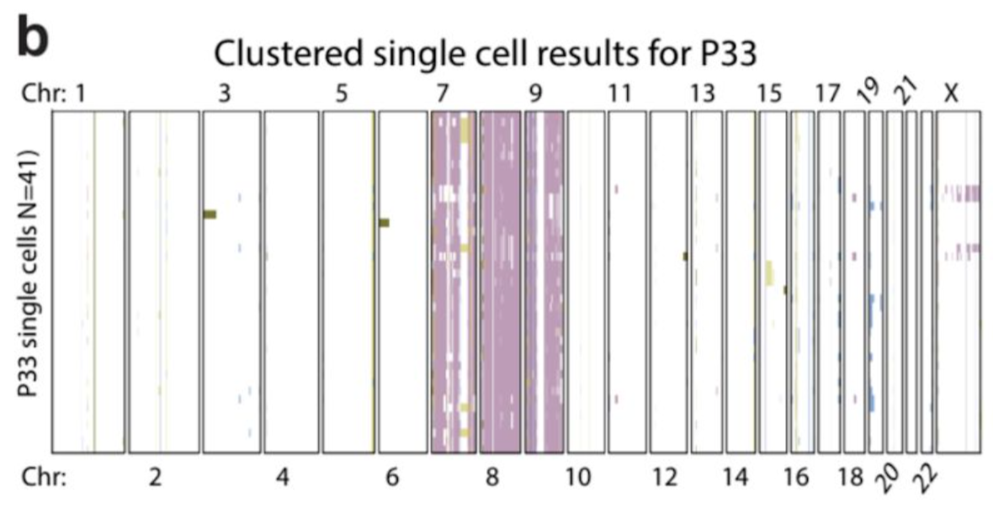
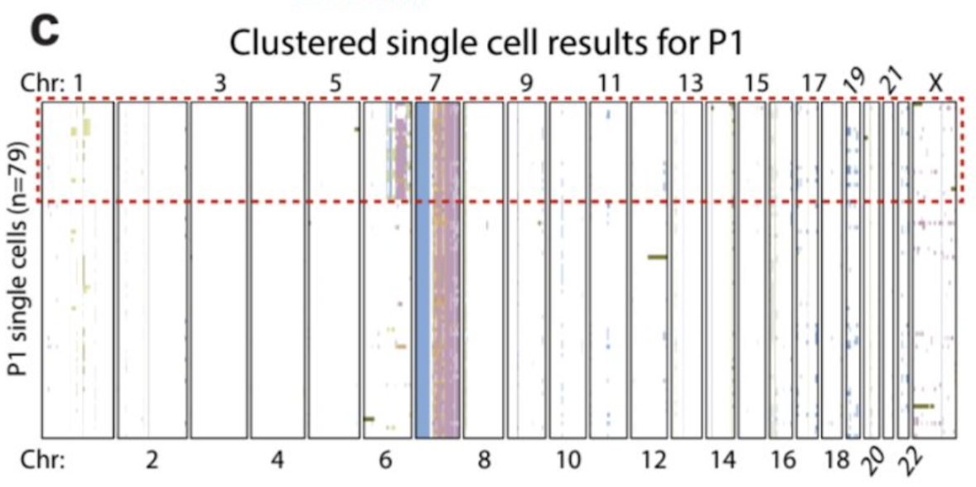
Heatmap of single-cells based on SVs called by MosaiCatcher framework
This heatmap was arranged using Ward’s method for hierarchical clustering of SVs genotype likelihoods in two PDX samples
P33 shows single dominant clone but P1 shows subclonal population in the sample represented by 25 cells

Slide 16
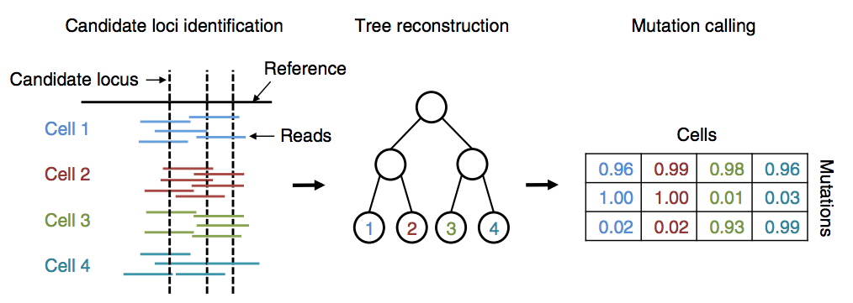
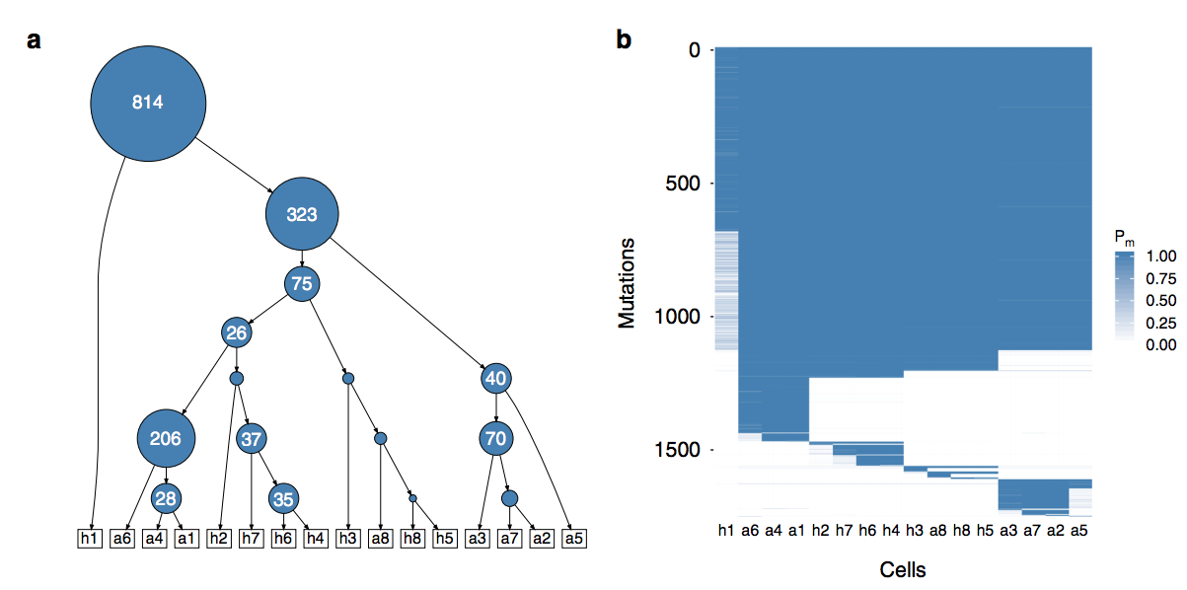
More tools for the clustering and Phylogenetics of single cells - SCIΦ
This method jointly calls mutations in individual cells and estimates the tumor phylogeny among these cells.
Employing a Markov Chain Monte Carlo scheme enables us to reliably call mutations in each single cell even in experiments with high drop-out rates and missing data.
Singer et al. Nat Comm, 2018
Niko Beerenwinkel group
Notes:
Single-cell mutation identification via phylogenetic inference

Slide 17
More tools for the clustering and Phylogenetics of single cells – E-scape
Smith et al. Nat Methods, 2017 Sohrab P Shah group
E-scape consists of three visualization tools deployed as R html widgets
1) TimeScape for time series analysis
2) MapScape for spatial distribution analysis
3) CellScape for single-cell analysis, including analysis of the phylogenetic and population dynamics of cancer – the heatmap depicts genome-wide CNVs across single cells. The tree illustrates the evolutionary relationships between cells.
Notes:
E-scape: interactive visualization of single-cell phylogenetics and cancer evolution
CellScape facilitates interactive browsing of single cell clonal evolution datasets. The tool requires two main inputs: the genomic content of each single cell in the form of either copy number segments or targeted mutation values, and a single cell phylogeny. Phylogenetic formats can vary from dendrogram-like phylogenies with leaf nodes to evolutionary model-derived phylogenies with observed or latent internal nodes. The CellScape phylogeny is flexibly input as a table of source-target edges to support arbitrary representations, where each node may or may not have associated genomic data. The output of CellScape is an interactive interface displaying a single cell phylogeny and a cell-by-locus genomic heatmap representing the mutation status in each cell for each locus
We learned the phylogenetic tree from the single cell copy number data. In traditional phylogenetic algorithms, e.g. neighbour-joining, the internal nodes and leaves of the tree are assigned to unobserved ancestors and observed genotypes, respectively. However, we used a novel algorithm that can assign observed genotypes to internal nodes. This is an important capability for single cell cancer data, where both descendants and ancestors can be observed in a sample. The phylogeny is available in Supplementary Table 19.

Slide 18
Summary
Single-cell whole-genome sequencing and Strand-seq are the representative technologies for the single-cell genomics
BWA-MEM and bowtie2 are the aligners commonly used in the single-cell genomics
In addition to genomic position, orientation of the alignment (Crick, Watson) is important in Strand-seq analysis
Presentation from David
MosaiCatcher is the computational algorithm to detect characteristic footprint of diverse SV classes from the Strand-seq data
Timescape, etc can be used for the clustering and phylogenetics of single-cell genomics data

